Slide 1
UPPER SIXTH ARTS
GEOGRAPHY
Lesson 1
Pollution
Notes:
Good morning, class, and welcome to our geography lesson. I am your geography teacher, Mr Kamdem. Today we are starting Lesson 1: Pollution.

Slide 2
CLASS INFO
Class, Chapter and Duration
Class | Upper Sixth Arts
Chapter | Module 7: Understanding and managing contemporary environmental and development issues
Duration | 2 periods (2 × 50 minutes)
Notes:
This lesson is for Upper Sixth Arts. It belongs to Module 7: Understanding and managing contemporary environmental and development issues. We shall need 2 periods to cover it.

Slide 3
IDENTIFICATION
Lesson Identification
Topic | Contemporary Environmental Issues
Sub-topic | Environmental Degradation
Lesson | Lesson 1: Pollution
Notions / Concepts | Pollution, pollutant, acid rain, eutrophication, recycling.
Syllabus focus | Main types (water, air, land); meaning, pollutants and sources; nature and magnitude; causes; effects on people and the environment; solutions (legislation, technology, recycling, disposal, international cooperation).
Competence | Learners are able to identify types of pollution, explain their causes and effects and propose solutions.
Notes:
Our topic is Contemporary Environmental Issues, and the sub-topic is Environmental Degradation. The key notions we shall use today are: pollution, pollutant, acid rain, eutrophication, recycling. At the end, you should be able to do this: learners are able to identify types of pollution, explain their causes and effects and propose solutions.

Slide 4

HOMEWORK CORRECTION
Correction of the Homework
Question (Further Study 7: Tourism Development in Cameroon):
Prepare a short advertisement for a tourist site in your region.
Notes:
Before we start the new lesson, let us correct the homework I gave you at the end of Further Study 7: Tourism Development in Cameroon. The question was: Prepare a short advertisement for a tourist site in your region. Take out your exercise books.

Slide 5
HOMEWORK CORRECTION
Correction: Possible Answer
Answers vary. A good advertisement names the site and region, shows what to see and do, how to get there, where to stay and a catchy slogan.
Notes:
Here is a good answer. Answers vary. A good advertisement names the site and region, shows what to see and do, how to get there, where to stay and a catchy slogan. Compare it with your own answer and correct your work in red.

Slide 6
LESSON PLAN
Lesson Plan
Correction of the homework
Objectives and recall
Real-life situation and action to take
Learning activities
Board summary
Evaluation, remediation and homework
Notes:
Here is the plan of our lesson today. First, we shall correct the homework. Then we shall look at the objectives and recall what you already know. After that, we shall study a situation from real life and the action to take, and do the learning activities. Finally, we shall copy the board summary, do the evaluation and the remediation, and I will give you the homework.

Slide 7
OBJECTIVES
Objectives
By the end of this lesson, you should be able to:
Define pollution and name its main types.
Explain the causes and effects of pollution.
Propose solutions to pollution.
Notes:
By the end of this lesson, you should be able to do three things. Number 1: define pollution and name its main types. Number 2: explain the causes and effects of pollution. Number 3: propose solutions to pollution.

Slide 8
PREVIOUS KNOWLEDGE
Previous Knowledge
Factories and cars produce smoke.
Rubbish is thrown in drains and rivers.
Notes:
Let us first remember what you already know. Factories and cars produce smoke. Rubbish is thrown in drains and rivers. Keep this in mind, because we shall build on it today.

Slide 9
REAL-LIFE SITUATION
Situation in Real Life
In Douala, plastic bags block the gutters, smoke from factories and old cars fills the air and some people drink water from polluted wells. Many children have coughs and diarrhoea.
Notes:
Listen carefully to this situation from real life. In Douala, plastic bags block the gutters, smoke from factories and old cars fills the air and some people drink water from polluted wells. Many children have coughs and diarrhoea. Think about it, because I am going to ask you some questions.

Slide 10
REAL-LIFE SITUATION
Situation: Question 1
What is the problem in the situation?
Notes:
Question 1: What is the problem in the situation? Think for a moment, then raise your hand to answer.

Slide 11
REAL-LIFE SITUATION
Answer
Air, water and land are polluted.
Notes:
Good. Air, water and land are polluted.

Slide 12
REAL-LIFE SITUATION
Situation: Question 2
Give two sources of pollution in the situation.
Notes:
Question 2: Give two sources of pollution in the situation. Think for a moment, then raise your hand to answer.

Slide 13
REAL-LIFE SITUATION
Answer
Plastic waste and smoke from factories and cars.
Notes:
Good. Plastic waste and smoke from factories and cars.

Slide 14
REAL-LIFE SITUATION
Situation: Question 3
Give one effect on people.
Notes:
Question 3: Give one effect on people. Think for a moment, then raise your hand to answer.

Slide 15
REAL-LIFE SITUATION
Possible Answer
Coughs and diarrhoea.
Notes:
Good. Coughs and diarrhoea.

Slide 16
ACTION TO TAKE
Action to Take
Reduce, reuse and recycle waste and never burn plastics.
Notes:
From this situation, the action we are working towards in this lesson is the following: reduce, reuse and recycle waste and never burn plastics.

Slide 17
JUSTIFICATION
Justification of the Lesson
This lesson helps us to understand pollution and to protect our health and environment.
Notes:
Why is this lesson important for you? This lesson helps us to understand pollution and to protect our health and environment.

Slide 18
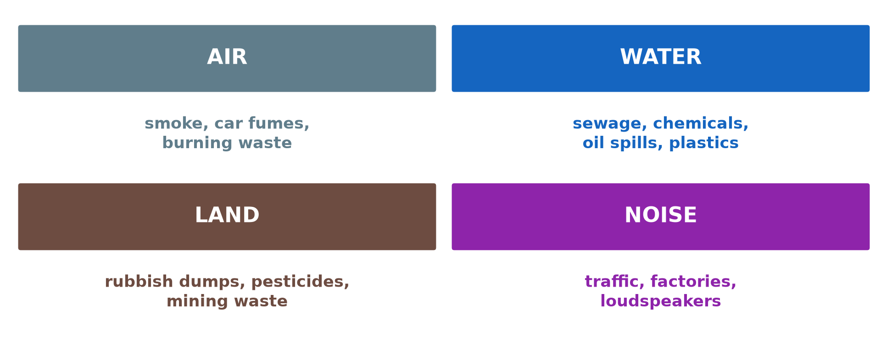
1. MEANING AND TYPES
Activity 1
The main types of pollution.
Notes:
Activity 1. Look carefully at this diagram: the main types of pollution. Observe every detail before I ask the question.

Slide 19
1. MEANING AND TYPES
Activity 1: Question
Name the three main types of pollution.
Notes:
Here is the question for Activity 1: Name the three main types of pollution. Take one minute to think and write your answer in your rough notebook.

Slide 20
1. MEANING AND TYPES
Activity 1: Answer
Air, water and land pollution (also noise).
Notes:
Let us check the answer together. Air, water and land pollution (also noise).

Slide 21

2. AIR POLLUTION
Activity 2
Smoke from factory chimneys.
Notes:
Activity 2. Look carefully at this picture: smoke from factory chimneys. Observe every detail before I ask the question.

Slide 22
2. AIR POLLUTION
Activity 2: Question
Give two sources of air pollution.
Notes:
Here is the question for Activity 2: Give two sources of air pollution. Take one minute to think and write your answer in your rough notebook.

Slide 23
2. AIR POLLUTION
Activity 2: Answer
Factories and car exhaust (also burning waste and bush fires).
Notes:
Let us check the answer together. Factories and car exhaust (also burning waste and bush fires).

Slide 24
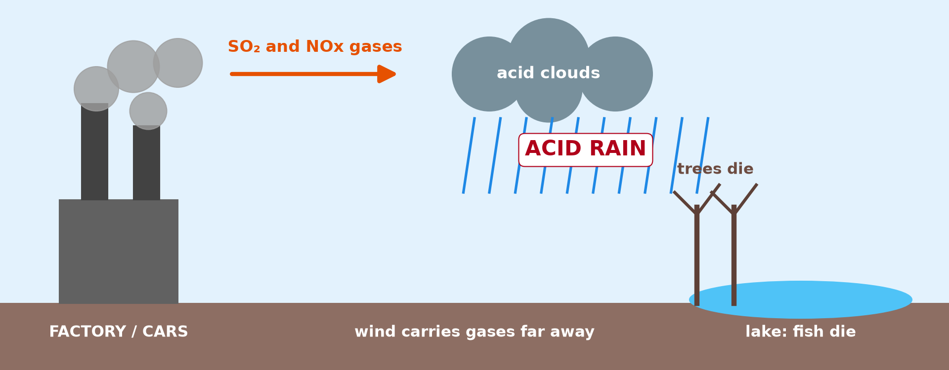
2. ACID RAIN
Activity 3
How acid rain forms.
Notes:
Activity 3. Look carefully at this diagram: how acid rain forms. Observe every detail before I ask the question.

Slide 25
2. ACID RAIN
Activity 3: Question
Explain how acid rain forms.
Notes:
Here is the question for Activity 3: Explain how acid rain forms. Take one minute to think and write your answer in your rough notebook.

Slide 26
2. ACID RAIN
Activity 3: Answer
Sulphur and nitrogen gases mix with water in clouds and fall as acid rain.
Notes:
Let us check the answer together. Sulphur and nitrogen gases mix with water in clouds and fall as acid rain.

Slide 27
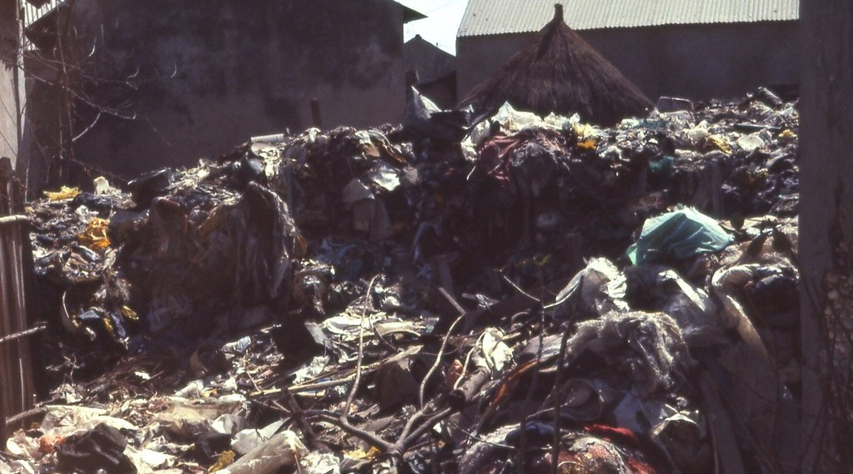
2. WATER AND LAND POLLUTION
Activity 4
A rubbish dump in West Africa.
Notes:
Activity 4. Look carefully at this picture: a rubbish dump in West Africa. Observe every detail before I ask the question.

Slide 28
2. WATER AND LAND POLLUTION
Activity 4: Question
Give two effects of rubbish dumps.
Notes:
Here is the question for Activity 4: Give two effects of rubbish dumps. Take one minute to think and write your answer in your rough notebook.

Slide 29
2. WATER AND LAND POLLUTION
Activity 4: Answer
They pollute water and soil and spread diseases like cholera.
Notes:
Let us check the answer together. They pollute water and soil and spread diseases like cholera.

Slide 30
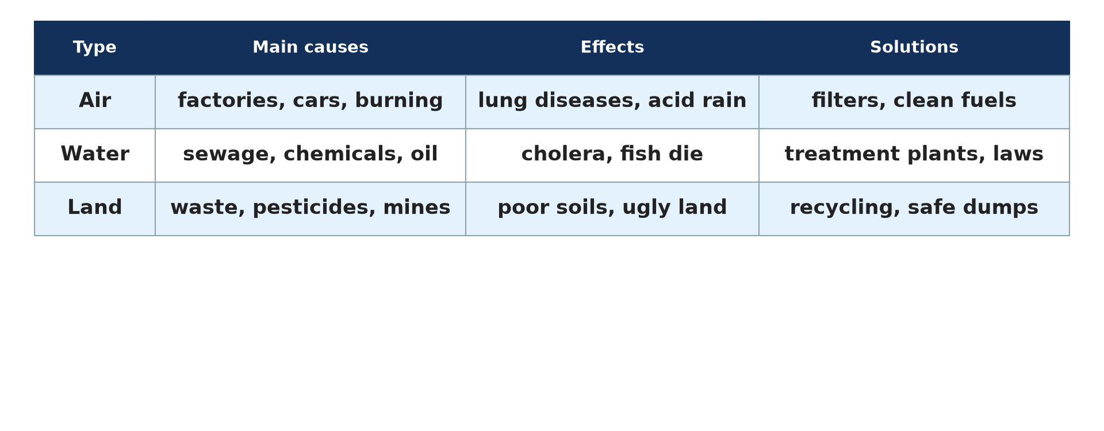
3. SOLUTIONS
Activity 5
Causes, effects and solutions.
Notes:
Activity 5. Look carefully at this diagram: causes, effects and solutions. Observe every detail before I ask the question.

Slide 31
3. SOLUTIONS
Activity 5: Question
Give three solutions to pollution.
Notes:
Here is the question for Activity 5: Give three solutions to pollution. Take one minute to think and write your answer in your rough notebook.

Slide 32
3. SOLUTIONS
Activity 5: Answer
Recycling, laws against dumping and treatment plants (also clean technology).
Notes:
Let us check the answer together. Recycling, laws against dumping and treatment plants (also clean technology).

Slide 33
BOARD SUMMARY
Board Summary
Topic: Contemporary Environmental Issues
Sub-topic: Environmental Degradation
Lesson 1: Pollution
Notes:
Now we are going to copy the board summary. Write the title and the headings neatly in your notebooks. I will give you enough time for each slide, so do not rush.

Slide 34
BOARD SUMMARY
1. Meaning and Types of Pollution
Pollution and its elements can be defined as follows:
Pollution: It is the addition of harmful substances or energy to the air, water or land. It happens faster than nature can break them down.
Notes:
Let us copy Meaning and Types of Pollution. Pollution and its elements can be defined as follows. On this slide we have Pollution. Write each point on a new line, with the key term first, and explain it in your own words when we revise. When you finish, we go to the next slide.

Slide 35
BOARD SUMMARY
1. Meaning and Types of Pollution (continued)
Pollutant: It is a substance that causes pollution, such as smoke, oil, plastics, pesticides or sewage. It can come from a point source like a chimney or from a diffuse source like farmland.
Notes:
We continue with Meaning and Types of Pollution. On this slide we have Pollutant. Write each point on a new line, with the key term first, and explain it in your own words when we revise. When you finish, we go to the next slide.

Slide 36
BOARD SUMMARY
1. Meaning and Types of Pollution (continued)
Magnitude: Pollution can be local (a dump), regional (acid rain) or global (greenhouse gases). It is worst in fast-growing industrial cities of Asia and in big African cities.
Notes:
We continue with Meaning and Types of Pollution. On this slide we have Magnitude. Write each point on a new line, with the key term first, and explain it in your own words when we revise.

Slide 37
BOARD SUMMARY
1. Meaning and Types of Pollution
Illustration: the main types of pollution
Notes:
Now draw this illustration in your notebook: the main types of pollution. Give it a title and label it clearly.

Slide 38
BOARD SUMMARY
2. Causes and Effects
A) Air Pollution
Air pollution has the following causes and effects:
Causes: Smoke from factories, vehicles, power stations and burning waste releases sulphur dioxide, nitrogen oxides and dust.
Notes:
Let us copy Air Pollution. Air pollution has the following causes and effects. On this slide we have Causes. Write each point on a new line, with the key term first, and explain it in your own words when we revise. When you finish, we go to the next slide.

Slide 39
BOARD SUMMARY
2. Causes and Effects
A) Air Pollution (continued)
Bush fires also pollute the air in the dry season.
Notes:
We continue with Air Pollution. Copy this carefully. When you finish, we go to the next slide.

Slide 40
BOARD SUMMARY
2. Causes and Effects
A) Air Pollution (continued)
Effects: Air pollution causes coughs, asthma and lung diseases. Sulphur and nitrogen oxides dissolve in rain to form acid rain, which kills trees and fish and damages buildings.
Notes:
We continue with Air Pollution. On this slide we have Effects. Write each point on a new line, with the key term first, and explain it in your own words when we revise.

Slide 41
BOARD SUMMARY
2. Causes and Effects
Illustration: how acid rain forms
Notes:
Now draw this illustration in your notebook: how acid rain forms. Give it a title and label it clearly.

Slide 42
BOARD SUMMARY
2. Causes and Effects
B) Water and Land Pollution
Water and land pollution have the following causes and effects:
Water pollution: Sewage, industrial waste, oil spills and fertilisers enter rivers and seas.
Notes:
Let us copy Water and Land Pollution. Water and land pollution have the following causes and effects. On this slide we have Water pollution. Write each point on a new line, with the key term first, and explain it in your own words when we revise. When you finish, we go to the next slide.

Slide 43
BOARD SUMMARY
2. Causes and Effects
B) Water and Land Pollution (continued)
Fertilisers cause eutrophication, in which algae grow and use up the oxygen, so fish die.
Notes:
We continue with Water and Land Pollution. Copy this carefully. When you finish, we go to the next slide.

Slide 44
BOARD SUMMARY
2. Causes and Effects
B) Water and Land Pollution (continued)
Land pollution: Rubbish dumps, plastics, mining waste and pesticides pollute the soil. They breed flies and mosquitoes and reduce soil fertility.
Notes:
We continue with Water and Land Pollution. On this slide we have Land pollution. Write each point on a new line, with the key term first, and explain it in your own words when we revise.

Slide 45
BOARD SUMMARY
3. Solutions to Pollution
Pollution can be reduced by the following solutions:
Legislation and technology: Laws fix limits on emissions and punish polluters. Filters, catalytic converters and treatment plants clean smoke and waste water.
Notes:
Let us copy Solutions to Pollution. Pollution can be reduced by the following solutions. On this slide we have Legislation and technology. Write each point on a new line, with the key term first, and explain it in your own words when we revise. When you finish, we go to the next slide.

Slide 46
BOARD SUMMARY
3. Solutions to Pollution (continued)
Recycling and disposal: Recycling paper, metal and plastics reduces waste. Sanitary landfills and incinerators dispose of rubbish safely.
Notes:
We continue with Solutions to Pollution. On this slide we have Recycling and disposal. Write each point on a new line, with the key term first, and explain it in your own words when we revise. When you finish, we go to the next slide.

Slide 47
BOARD SUMMARY
3. Solutions to Pollution (continued)
International cooperation: Treaties such as the Montreal Protocol and the Paris Agreement reduce global pollution. Countries share technology and money to clean the environment.
Notes:
We continue with Solutions to Pollution. On this slide we have International cooperation. Write each point on a new line, with the key term first, and explain it in your own words when we revise.

Slide 48
BOARD SUMMARY
3. Solutions to Pollution
Illustration: causes, effects and solutions
Notes:
Now draw this illustration in your notebook: causes, effects and solutions. Give it a title and label it clearly.

Slide 49
FORMATIVE EVALUATION
Evaluation 1
Give two causes and two effects of water pollution.
Notes:
Now let us check what you have understood. Question 1: Give two causes and two effects of water pollution. Answer in your exercise book.

Slide 50
FORMATIVE EVALUATION
Expected Answer
Causes: sewage, chemicals. Effects: cholera, fish die.
Notes:
The expected answer is: causes: sewage, chemicals. Effects: cholera, fish die. If you got it right, well done.

Slide 51
FORMATIVE EVALUATION
Evaluation 2
Give three measures to reduce pollution.
Notes:
Now let us check what you have understood. Question 2: Give three measures to reduce pollution. Answer in your exercise book.

Slide 52
FORMATIVE EVALUATION
Expected Answer
Recycling, laws and treatment plants.
Notes:
The expected answer is: recycling, laws and treatment plants. If you got it right, well done.

Slide 53
REMEDIATION
Remediation
Fill in the blanks:
Rain made acid by factory gases is ______ rain.
Algae growth caused by fertilisers is ______.
Using waste again is ______.
Notes:
For those who need more practice, fill in the blanks in your exercise book. The answers are: number 1, acid; number 2, eutrophication; number 3, recycling.

Slide 54
HOMEWORK
Homework
List the sources of pollution around your home and suggest one solution for each.
Notes:
For your homework: List the sources of pollution around your home and suggest one solution for each. We shall correct it at the beginning of our next lesson.

Slide 55
NEXT LESSON
Next Lesson
Our next lesson will be on:
Lesson 2: Deforestation and Desertification
Notes:
Our next lesson will be on Lesson 2: Deforestation and Desertification. Thank you for your attention, and see you next time.

Slide 56
BILINGUAL GAME
Bilingual Game (Jeu Bilingue)
English | Français
Pollution | La pollution
Waste | Les déchets
Smoke | La fumée
Sewage | Les eaux usées
Recycling | Le recyclage
Acid rain | Les pluies acides
Notes:
Let us play the bilingual game. I say a word in English, and you give me the French word. Then we do the reverse.

Slide 57
LOGBOOK
Official Logbook (1/2)
Module / Topic | Contemporary Environmental Issues
Lesson Title | Lesson 1: Pollution
Expected Learning Outcomes | Define pollution and name its main types. Explain the causes and effects of pollution. Propose solutions to pollution.
Competence | Learners are able to identify types of pollution, explain their causes and effects and propose solutions.
Notes:
I record this information in the official logbook of the class after the lesson.

Slide 58
LOGBOOK
Official Logbook (2/2)
Matter Taught | Meaning and Types of Pollution; Air Pollution; Water and Land Pollution; Solutions to Pollution.
Evaluation | Formative evaluation and remediation exercise.
Homework | List the sources of pollution around your home and suggest one solution for each.
Enrolment / Present / Absent | ____ / ____ / ____
Achievement | To be completed after the lesson.
Notes:
I complete the second page of the logbook: the matter taught, the evaluation, the homework and the attendance.

Slide 59
TEACHER'S NOTE
Teacher's Note
Timing: Homework correction, plan, objectives 8 min | Recall, situation, action 10 min | 5 activities 30 min | Board summary (copying) 30 min | Evaluation, remediation 10 min | Homework, next lesson 5 min | Logbook 7 min
Without the projector (Activity 1): list polluted places in your town.
Without the projector (Activity 2): describe smoke you see.
Without the projector (Activity 3): describe the steps.
Without the projector (Activity 4): discuss rubbish in your area.
Without the projector (Activity 5): suggest solutions for your school.
Notes:
This slide is for me, the teacher: it gives the timing of the lesson and what to do if the projector is not available.

Slide 60
REFERENCES
References
National Geography Syllabus, MINESEC/IGE/IP-SS, 2019 — Module 7 (Environment and Development).
Photo, Activity 2: “image replaced (thanks Anne :) )” by why 137, CC BY 2.0, via Flickr (https://www.flickr.com/photos/78752351@N03/8464430910)
Photo, Activity 4: “Garbage dump at Fadiouth, Senegal (West Africa)” by gbaku, CC BY-SA 2.0, via Flickr (https://www.flickr.com/photos/72105154@N00/906659197)
Diagrams and animations: drawn for this lesson (Geography Department).
Notes:
These are the references and picture credits used to prepare this lesson.

